Slide 1

Implementing 1958/1998 Agreement in Korea
Hyoung-gu, Kim
hyoungu35@kotsa.or.kr

Slide 2
Contents
Contents
Self-Certification System in Korea
Implementing 1958/1998 Agreement in Self-Certification System
2p

Slide 3
1. Self-Certification System in Korea
Self-Certification System in Vehicle Regulations
Type approval is granted to a product that meets a minimum set of regulatory, technical and safety requirements. Generally, type approval is required before a product is allowed to be sold in a particular country, so the requirements for a given product will vary around the world.
Self-certification system
Government provides the vehicle safety standards to manufacturers for securing the safety of vehicles.
Manufacturers certify themselves with their vehicles comply with the safety standards voluntarily and sell them in market without any vehicle approval from the government.
If vehicles in market do not meet the safety standards or have a defect affecting the safety driving, the government can order the recall to the manufacturers.
Item | Type Approval | Self-Certification
Before sale | Approval before sale TAA/TS, Certification testing | No approval for vehicle Manufacturer voluntarily testing
After sale | Conformity of Production(CoP) In-service conformity | Compliance Test, Recall if fail
3p

Slide 4



1. Self-Certification System in Korea
Function & Roles of MOLIT and KATRI
MOLIT
KATRI
Establish Policies / Plans
Act, Regulation Legislation
Initiate Defect Investigation
Recall Decision / Order
Collect Information
Carry out Compliance Test
Carry out Defects Investigation
R&D for Regulations
* MOLIT : Ministry of Land and Infrastructure, Transport
* KATRI : Korea Automobile Testing & Research Institute
4p

Slide 5
1. Self-Certification System in Korea
Motor Vehicle Management ACT
Purpose : ensuring performance and safety of vehicles as well as efficient management of vehicles
Vehicle Management Act
Act
Self-Certification system
Safety Standards for Motor Vehicles
Vehicle Management Act, Enforcement Decree
Vehicle Management Act, Enforcement rules
Ordinance of MOLIT
Technical
Regulation
KMVSS (Technical Regulation)
5p

Slide 6
1. Self-Certification System in Korea
Motor Vehicle Management ACT
Motor Vehicle Management ACT enacted in 1986
Purpose: efficient management of vehicles & ensuring performance and safety of vehicles
Vehicle
Management Act
General Rules
Vehicle
Registration
Vehicle Safety Standards
& Self Certification
Vehicle Examination
& Maintenance
Vehicle
Inspection
Management
of Motor cycle
Vehicle
Management
Business
Supplementary
Rules
Korea Motor Vehicles Safety Standards
Self-certification System
- Legal Basis : Article 29 enacted in 2003
- Legal Basis : Article 30 enacted in 2003
Penalty
Special Cases of Handling
Violation Acts
6p

Slide 7
1. Self-Certification System in Korea
Motor Vehicle Management ACT, Article 29
Article 29 (Structure and Devices of Motor Vehicles)(1) If the structure and devices of a motor vehicle as prescribed by Presidential Decree fail to meet the performance requirements and standards required for safe operation (hereinafter referred to as "safety standards for motor vehicles"), the motor vehicle shall not be operated.
Korea Motor Vehicle Safety Standards
No. 465 Ordinance of the Ministry of Land, Infrastructure and Transport
1. General Rules
• Purpose
• Definition Structure
• Equipment Safety
2. Safety Standard of
Vehicle & Motor cycles
• Length, width and height
• Gross vehicle weight, etc.
• Driving devices
• Control devices
• Lighting devices
3. Safety Standard of
Manufactured Vehicles
• Scope
• Acceleration control device
• Brake device
• Collision impact protection device
• Pedestrian safety
4. Supplementary Rules
• Passenger capacity,
Maximum loading capacity
• Special case of criterion application
• Tolerance of dimension
• Notification of test method
3-2. Vehicle parts
• Brake hose, Seatbelt, Lighting
Devices 13items
Supplementary Provisions
• Enforcement date
• Interim measures
7p

Slide 8
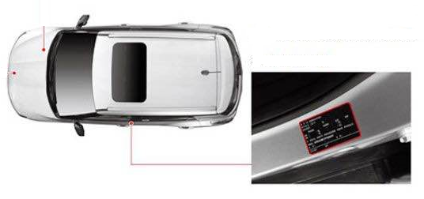
1. Self-Certification System in Korea
How to do the Self-Certification System in Korea?
1. Manufacturer Registration
Manufacturer and their safety test facilities should be registered to the Ministry of Land, Infrastructure and Transport(MOLIT) in order to enforce the responsibility of follow-up services including recall to the companies conducting self certification.
In case of imported vehicles, if the Korean representative of the foreign manufacturer is designated, the corresponding manufacturer is assumed to have the self certification capability
2. Self Certification Label
Self Certification Label
When the self certification is completed by the manufacturer, the label of self-certification should be displayed in the vehicle.
3. Notify the Vehicle Specification
Upon the completion of the self certification, the vehicle specification should be notified to the Performance Test Agent(National Vehicle Management Network System).
Then, manufacturer can get the Vehicle Specification Number which will be used for their vehicle registration through the National Vehicle Management Network System.
8p

Slide 9
1. Self-Certification System in Korea
Implementing procedure of Self-Certification System
<Procedure of Self-Certification>
Manufacturer Registration
(Vehicle Manufacturer, Assembler and Importer)
• Manufacturer, Assembler, and Importer
Applying for Self Certification
• Change Registration
The Ministry of Land, Infrastructure and Transport
• Identify the capability of self certification
• Assign manufacturer registration number
Unqualified Applicant
Technical Review
Safety Inspection
Manufacturer Self Certification
(Certification Marking Display)
• Compliance of self certification criteria
• Advance checking of important items
related to safety
Performance Research Lab
• Assign specification control number
Notification of Specification
9p

Slide 10
1. Self-Certification System in Korea
Compliance Test for Self-Certification System
Motor Vehicle Management ACT, Article 30-3, (2) In order to confirm whether a motor vehicle manufacturer, etc. or part manufacturer, etc. falls under any of the subparagraphs of paragraph (1), the Minister of Land, Infrastructure and Transport may have a performance test agent conduct the investigation of such fact. In such cases, the Minister of Land, Infrastructure and Transport shall subsidize the expenses incurred in such investigation.
Scope of Investigation
Whether self certification procedure or violate (False or other improper methods)
Whether Motor vehicles in compliance with the safety standards or not
Whether Vehicle manufactured was sold in proper way from the self certification or not
Whether there was a violation in the execution of recall order, etc.
Investigation Method
MOLIT establishes an annual plan including the target vehicle types and test items and orders the investigation(Compliance Test) to KATRI.
KATRI establishes the investigation plan and reports the details to the MOLIT.
KATRI conducts the investigation results to the MOLIT after the Compliance Test.
When the manufacturer voluntarily accepts the defects and reports the recall plan, MOLIT finishes the investigation.
When the result of the investigation shows incompliance to KMVSS, Penalty will be imposed, and recall will be ordered from MOLIT
10p

Slide 11
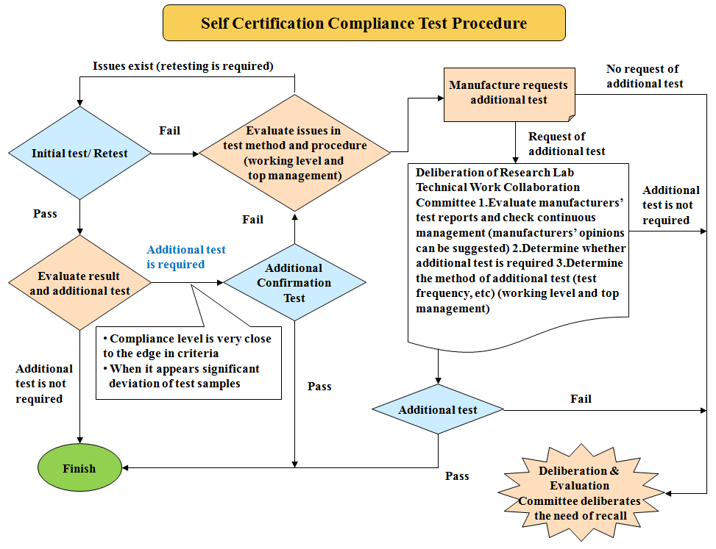
1. Self-Certification System in Korea
Compliance Test Investigation Procedure
<Compliance Test Flow>
11p

Slide 12
Contents
Self-Certification System in Vehicle Regulations
Implementing 1958/1998 Agreement in Self-Certification System
12p

Slide 13
2. Implementing 1958/1998 Agreement in Self-Certification System
Status of the Korean accessions on Agreements(UN/ECE/WP.29)
1958 Agreement (UN Regulation)
1958
Agreement
Unification of
Reg.
Mutual
Recognition
=
+
Accession Date : 2004.12.31
Contracting Parties : 57 Countries
UN Regulations : 152 items
1998 Agreement (UN GTR : UN Global Technical Regulations)
1998
Agreement
Unification of
Reg.(GTR)
=
Accession Date : 2001.1.1
Contracting Parties : 38 Countries
UN Regulations : 20 items
13p

Slide 14
2. Implementing 1958/1998 Agreement in Self-Certification System
Status of Harmonization with UN Regulations in KMVSS
Summary of Harmonized Regulations in KOREA (2006 ~ 2015)
73 UN regulations and 14 UN GTRs were introduced into KMVSS capability
Year | UN Regulation | UN GTR
2006 | R13H : Passenger vehicle brake R19 : Front fog lamp | GTR No. 1 : Door locks & retention
2008 | R14 : Safety belt anchorages R39 : Speedometer R53 : Motorcycle installation R57 : Motorcycle headlamp R73 : Lateral Protection R95 : Side Collision R107 : Safety Inclination angle R123 : Semi-AFS | GTR No. 3 : Motorcycle brake GTR No. 9 : Pedestrian safety
2009 | R48 : Hazard warning signal | -
2010 | R6 : Side direction indicator R10 : EMC R13 : Spring brake R46 : Rear view mirror R79 : Steering effort R87 : DRL R112: Asymmetric headlamps R123 : Full AFS R125 : Field of Vision | GTR No. 6 : Safety glazing GTR No. 7 : Head restraint GTR No. 8 : ESC
2011 | R42 : Bumper R64 : TPMS R85 : Engine and Net power R91 : Side marker Lamp | -
Year | UN Regulation | UN GTR
2012 | R1,2,8,20,72,112,113 : Headlamps for motorcycle R13 : Brake Assist System(BAS) R53 : Light & Lighting devices for motorcycle R107 : Minimum Turning Radius | -
2014 | R3 : Retro-reflecting devices R4 : Rear registration plate lamps R7 : Front & rear position lamps, Stop- lamps, End-outline Marker Lamps R16 : Seat belts R21: Power-operation of Windows R23 : Reversing lamps R30, 54 : Pneumatic Tyres R38 : Rear fog lamps R55 : Coupling components R58 : Rear underrun protection R70 : Rear marking plates R98 : Gas Discharge headlamps R100 : Battery electric vehicle R119 : Cornering lamps | GTR No. 4 : WHDC GTR No. 5 : ODB GTR No. 13 :The hydrogen and Fuel cell vehicles
2015 | - | GTR No. 11 : Engine emissions for Non-Road Machinery
14p

Slide 15
2. Implementing 1958/1998 Agreement in Self-Certification System
Status of Harmonization with UN Regulations in KMVSS
Summary of Harmonized Regulations in KOREA (2017 ~ 2020)
73 UN regulations and 14 UN GTRs were introduced into KMVSS capability
Year | UN Regulation | UN GTR
2017 | R18 : Protection against unauthorized use R27 : Advance warning triangles R36 : Construction of public service vehicles(space for fire extinguisher) R66 : Strength of the superstructure of large passenger vehicles R69 : Rear marking plates for slow moving vehicles R75 : Pneumatic tyres(moped, motorcycle) R81 : Rear-view mirrors(motorcycle) R 90 : Replacement brake lining assemblies R121 : Identification of controls & tell-tales R124 : Passenger car wheel R127 : Pedestrian Safety Performance R130 : Lane departure warning system R131 : Advanced Emergency Braking System (AEBS) | GTR No. 2 : Motorcycle emission GTR No. 17 : Crankcase & evaporative emissions of L category vehicles GTR No. 18 : On-Board Diagnostic (OBD) systems for L-category Vehicles
Year | UN Regulation | UN GTR
2018 | R77 : Parking Lamps R94 : Frontal collision protection R135: Pole side Impact R137 : Frontal impact with focus on restraint systems R138 : Quiet Road Transport Vehicle (QRTV) R139 : Brake Assist Systems R140 :Electronic Stability Control R141 : Tyre Pressure Monitoring System | GTR No. 14 : Pole side impact
2019 | R148 : Light Signalling Devices R149 : Road Illumination Devices R150 : Retro-Reflective Devices
15p

Slide 16
2. Implementing 1958/1998 Agreement in Self-Certification System
Enactment & Revision Procedure
Opinions of Government
Opinions of Korea
Automobile Testing &
Research Institute (KATRI)
Initiation of Enactment /
Revision
Opinions of Manufacturers
And Relevant Institutions
Request of consideration
from the Ministry of Land,
Infrastructure and Transport
(MoLIT)
KATRI
Receives the Request
No
Detailed Review of
Enactment /Revision Case
Collection of Opinions from
Manufacturer and
Relevant Institutions
Prepare Draft of
Enactment / Revision
Submission to the MLTM
Affairs
Yes
16p

Slide 17
2. Implementing 1958/1998 Agreement in Self-Certification System
Enactment & Revision Procedure
Effect evaluation &
WTO Circular notice
Prepare Draft for Advance
Legislation Notification
and Advance Notification
Collection of Opinions from
Manufacturer and
Relevant Institutions
Prepare Regulation Effect
Assessment
Regulation Deliberation
No
Supplementation &
Explanation
Yes
Deliberation by Office of
Legislation
Prepare final amendments
No
Supplementation &
Explanation
Yes
Proclaim final rule &
Transmit WTO TBT
notification
Submission National
Assembly
17p

Slide 18

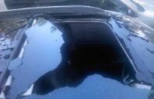
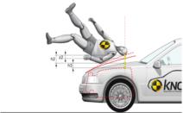
2. Implementing 1958/1998 Agreement in Self-Certification System
Main activities in WP.29
- Participation in WP.29 plenary meetings & 6 GRs
* Vice Chair of GRSP since 2014
- Participation in 17 Informal Working Groups (as of Dec. ‘20)
Chair & Vice-chair
AV & Others
Autonomous Vehicle
- FRAV(Functional Requirement for AV)
- Cyber Security & OTA
- VMAD (Validation Method For AD)
- AEBS for passenger vehicles
- DSSAD/EDR
Other Informal Working Groups
- Electric Vehicle Safety(EVS)
- Electric Vehicle and Environment(EVE)
- Simplifications of the Lighting and Lighting Signaling
Regulations(SLR)
- Visibility, Glare and Levelling
- WLTP Phase 2
- GTR No.7 Phase 2 (Head restraint System)
- EPPR IWG, GTR No.16 (Tires) Phase 2
- STCBC(Safer Transport of Children in Buses and Coaches)
Chairmanship
- (GRSG) Panoramic Sunroof Glazing IWG
- (GRSP) UN GTR No.9 Phase 2 : Deployable
Pedestrian Protection System
Vice-Chairmanship
- (GRPE) Vehicle Interior Air Quality (VIAQ)
- (GRSP) UN GTR No.13(HFCV) Phase 2
TF Leader
- (GRSP) UN GTR No.13(HFCV) Phase 2
18p

Slide 19
Thank you for your attention
Hyoung-gu, Kim
hyoungu35@kotsa.or.kr
19p

