Slide 1
The 11th Public and Private Joint Forum In Asian Region (January 26-27, 2021) Country Report on 'Recent situation of the measures related to vehicle safety and environment' India

Slide 2
Regulatory Mechanism - Stakeholders
Government of India
MORTH
Ministry of Road Transport & Highways
Standardization
MOHI
Ministry of Heavy Industries & Public Enterprises
CMVR-
Technical Standing Committee
Certification Agencies
MOEF
Ministry of Environment & Forests
1. ARAI – The Automotive Research Association of India
2. VRDE – Vehicle Research Development Establishment
3. CIRT – Central Institute of Road Transport
4. ICAT – International Centre for Automotive Technology
5. IIP – Indian Institute of Petroleum
6. CFMTTI – Central Farm Machinery Testing & Training Institute
7. NRFMTTI – Northern Region Farm Machinery Testing &
Training Institute
8. GARC – Global Automotive Research Centre (GARC)
9. NATRAX – National Automotive Test Tracks
Automotive Industry Standards Committee-AISC
Ministry of Consumer Affairs
Standing Committee on Emission Legislation- SCOE
DGFT
Director General Foreign Trade
State Ministries
Bureau of Indian Standards-BIS

Slide 3
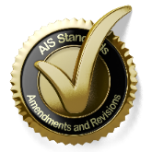
Regulatory Mechanism - Stakeholders
National Committees
Various National committees monitor the work related to automotive regulations.
01
CMVR-TSC & SCOE
MVA
Apex Committees working on Safety and Emission Regulations
IS
CMVR
AIS
02
AISC
Subsidiary Committee to CMVR-TSC and SCOE for formulating and approving standards
03
Technical Panels
Group of Experts supporting AISC and BIS for formulating Standards
UN R
UN GTR
MVA Motor Vehicle Act
CMVR Central Motor Vehicle Rules
IS Indian Standards
AIS Automotive Industry Standards
UN GTR UN Global Technical Regulations
UN R UN Regulations
04
India WP.29 Activities
Harmonization of Standards

Slide 4
National Committees - Composition
Standing Committee on Emissions (SCoE)
CMVR-Technical Standing Committee (CMVR-TSC)
Chairman: Joint Secretary (MoRT&H)
Members: MoP&NG, MoHI&PE, MoEF, NATRiP, Test Agencies, SIAM, TMA & Others
Chairman: Joint Secretary (MoRT&H)
Members: MoHI&PE, NATRiP, Test Agencies, BIS, SIAM, TMA, ACMA & Others
MoRT&H
National Standing Committee
on WP.29
Automotive Industry Standard Committee (AISC)
Chairman: Joint Secretary (MoRT&H)
Members: MoHI&PE, MoEF, DoC, DIPP, NATRiP, Test Agencies, BIS, SIAM, TMA, ACMA & Others
Chairman: Director (ARAI)
Members: MoRT&H, MoHI&PE, MoSSI, NATRiP, Test Agencies, BIS, SIAM, TMA, ACMA & Others

Slide 5
Features of Indian Type Approval System
Type Approval system is similar to UN-ECE
Implemented in year 1991
Type Approval administration
Notifying agencies: Primarily MoRTH
Standards and other requirements are notified under CMVR
Testing agencies: Notified under Rule 126
TA certificates: Issued by Testing Agencies
Test standards
Bureau of Indian Standards (BIS) prepares IS standards
AISC Technical committee prepares AIS standards as an interim step
Emission Test Procedure as per TAP/ 115-116 Document. Future standards will be published as AIS.
Roadmap of Regulations
Agreed by industry, test agencies and government
Standards are aligned with UN Regulations / Global Technical Regulations (GTR) to the extent possible

Slide 6
Governing Factors
Technological Advancement
Social Requirements
National
Rules / Act
Inputs from National Committees
International Harmonization
Ministry of Road Transport & Highways is the nodal Ministry for motor vehicle regulations in India

Slide 7
Motor Vehicle (Amendment) Act, 2019
Key provisions in Motor Vehicles (Amendment) Act, 2019
Mandatory fitness test through Automated Centres
New provision for ELV
New Section on Vehicle Recall
Safety of Pedestrians and Non Motorized Transport
Safety of Children during Commute
Electronic Monitoring and Enforcement of Road Safety
New Section for Good Samaritan, Golden Hour treatment, No fault liability
Penalties
Schemes for interim relief for accident victim claimants
Constitution of Motor Vehicle Accident relief Fund
Formulation of Road Safety Board
Various Central Motor Vehicle Rules concurrent with Motor Vehicle (Amendment) Act, 2019 are under process.

Slide 8
India’s Safety Commitments
India is a signatory to Brasilia Declaration and is committed to reduce the number of road accidents and fatalities.
- Reference – Report : Road Accidents in India 2015 – MoRTH
Excerpts from Brasilia Declaration
Recommended actions to develop & promote the use of safer vehicles
seat belts, air bags and active safety systems such as ABS & ESC fitted as standard, air quality, vehicle disposal
Recommended actions to increase awareness &
build capacity of road users
professional drivers' work conditions
Recommended actions to strengthen cooperation &
coordination towards global road safety
develop national, regional & global targets to reduce road traffic crashes & fatalities. (WHO, UNECE, Stakeholders)

Slide 9
Candidate global targets and indicators for review
1
Frontal impact protection and side impact protection
Core Area - Safer Vehicles
2
Electronic Stability Control
Objective:
Eliminate production (and importation) of substandard new vehicles.
Target:
100% of new vehicles (defined as produced or sold) meeting priority standards (based on UN regulations or equivalent recognised national standards).
3
Pedestrian front protection
4
The seat-belt regulation
5
The child restraint regulation
6
Motorcycle antilock braking systems

Slide 10
Accident Statistics (India)
2008
Road Accidents
4,84,704
Persons Injured
5,23,193
Fatalities 1,19,860
Every hour
55 accidents &
14 deaths
2018
Road Accidents
4,67,004
Persons Injured
4,69,418
Fatalities 1,51,417
Every hour
53 accidents &
17 deaths
2018 Vs 2008
Fatalities
2018 Vs 2015
Road Accidents, Persons Injured
Source: MoRTH - Road Accidents in India (2008 & 2018)

Slide 11
Fatality Vs Vehicle Population
Years | Population of India (in thousand) | Road Accident Risk (normalized for pop)* | Road Accident Death Risk (normalized for pop)$ | Total number of registered vehicles (in thousand) | Road accident Rate (normalized for vehicles)# | Road accident death rate (normalized for vehicles)## | Vehicle Density $$
1990 | 8,35,000 | 33.8 | 6.5 | 19,152 | 147.6 | 28.2 | 10
2000 | 10,14,825 | 38.6 | 7.8 | 48,857 | 80.1 | 16.2 | 15
2005 | 10.95,722 | 40.1 | 8.7 | 81,502 | 53.9 | 11.7 | 21
2010 | 11,76,742 | 42.5 | 11.4 | 1,27,746 | 39.1 | 10.5 | 28
2015 | 12,54,019 | 40.0 | 11.7 | 2,10,023 | 23.9 | 7.0 | 38
2016 | 12,68,961 | 37.9 | 11.9 | 2,30,031 | 20.9 | 6.6 | 41
2017 | 12,83,601 | 36.2 | 11.5 | 2,53,311 | 18.4 | 5.8 | 43
2018 | 12,98,043 | 36.0 | 11.7 | -- | -- | -- | --
≈3 times reduction
≈3 times increase
*Road Accident Risk : Number of accidents per lakh population
$Road Accident Death Risk : Number of persons killed per lakh population
#Road Accident Rate : Number of accidents per ten thousand vehicles
##Road Accident Death Rate : Number of persons killed per ten thousand vehicles
$$Vehicle Density : Number of Vehicles per km of Road
Source: MoRTH - Road Accidents in India (2018)

Slide 12
Safety Norms – History / Future
Significant Step in last 5 years
Brakes / High speed Braking
Steering Effort
Seat Belt & Anchorages
Gradeability
Tell tales & Controls
Lighting
Crash Norms
Airbags, CRS
Speed and seat belt alert
Pedestrian Safety
ABS
EMI / EMC
AHO
Sleeper Coaches
Double Deck Buses
ESC
Safety Roadmap for CEVs
Safety features for 2 W – Stands, Foot rest, external projections
Future Subjects
AEBS
ADAS
New Technologies
Pass by noise
CoP of components
Survival Space
Strength of Superstructure
Retro-reflectors
Safety - BoV
2000-05
Spray suppression
Demist & Defrost
Traction Batteries
EMC
2005-10
2015-20
2020-
2010-15

Slide 13
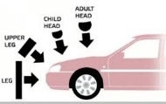
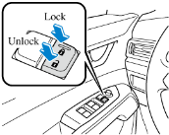
Passenger Car – Key New Requirements
Airbag
1
Driver Airbag is mandatory
Seat Belt Reminder
2
Driver and Co Driver Seat Belt Reminder
Manual Override for Central Locking
3
Manual override for protection against lock down
Rear Parking Assist System
4
RPAS for safe parking
Crash Standards
5
Mandatory Crash Standards.
Pedestrian safety
6
Car design for ensuring pedestrian safety in event of crash

Slide 14
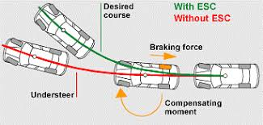
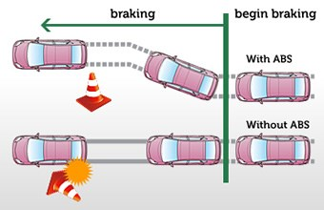
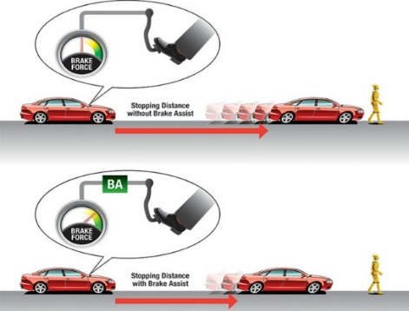
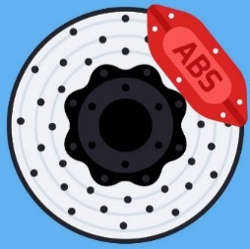
Main slide – used for hyperlink interaction do not delete
Safety Requirements - Braking
Braking
Electronic Stability Control System
If fitted for M1/N1 &
Mandatory for Buses
ABS for almost all
categories of vehicles
Revised Braking Standards fro All Categories of Vehicles
Brake Assist Systems - If fitted for M1 and N1
ABS or CBS for two Wheelers

Slide 15
Electric Vehicles
AIS 038 (Rev. 2)
AIS 041 (Rev. 1)
Construction Safety
Scope: M & N category
In CMVR: AIS 038 (Rev. 1)
New Adopted : AIS 038 (Rev. 2)
Inline with GTR 20 Phase 1 and UN R 100 Rev 3 Transposition Document
Proposed for Notification
Measurement of Net Power & Maximum 30 Minute Power
Scope: L, M & N category
In CMVR: AIS 041 (Rev. 1)
Inline with UN R 85
UN R 85 Rev. 1 available
(No technical change
for Motor)
AIS 156
AIS 040 (Rev. 1)
Construction Safety
Scope: L category
In CMVR: AIS 038 (Rev. 1)
New Adopted: AIS 156
Inline with UN R 136
Proposed for Notification
Measurement of Range
Scope: L, M & N category
In CMVR: AIS 040 (Rev. 1)
Inline with UN R 101 Rev. 3
AIS 039 (Rev. 1)
Measurement of Electrical Energy Consumption
Scope: L, M & N category
In CMVR: AIS 039 (Rev. 1)
Inline with UN R 101 Rev. 3

Slide 16
Advance Requirements for Buses (To Improve Public Transport)
Requirements for wheelchair and its accommodation for person with reduced mobility
G
A
Interior Noise, Vibration and Harshness
Requirements for Priority Seats & Space for Passengers with Reduced Mobility
F
B
Braking Performance & Vehicle Stability Function
Requirements for kneeling system, Ramp, Lift for person with reduced mobility
E
C
Fire Detection & Alarm System Fire Detection & Suppression System
D
Emergency Lighting System

Slide 17
Codes for Truck and Trailers
Requirements for Trailers
Requirements for Truck Cabin and Load Body
Focus on improving the Logistics Segment to enhance safety as well as efficiency.

Slide 18
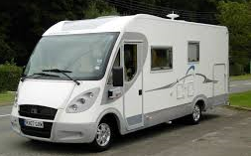
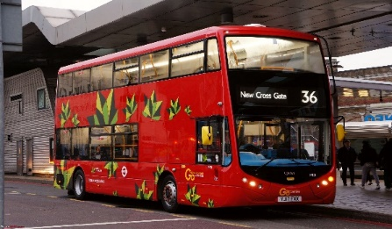
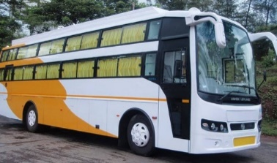
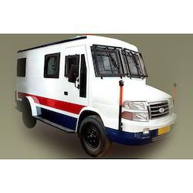
Special Purpose Vehicles
Specific Codes for Special Purpose Vehicles
Ambulance Code
Reefer Van
Motor Caravan
Food Truck
School Bus
Sleeper Coaches
Double Deck Buses
Cash Vans

Slide 19
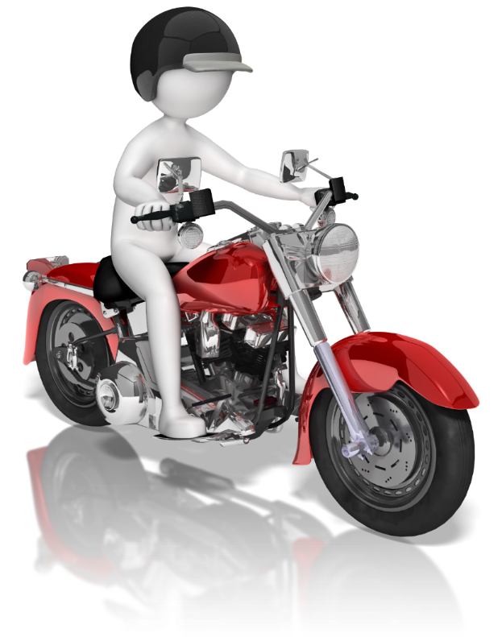
Safety Features in Motorcycles
AIS146
Stands
AIS 147
External Projections
AIS 148
Foot Rest
AIS 146 (Stands) : Reference Standard Annex XVI of EU directive 44/2014. Stability Requirement, Durability, Automatic Retraction while vehicle moving or disable vehicle propulsion if side stand is on.
AIS 147 (External Projections) : Reference Standard : Annex VIII of EU directive 44/2014.
AIS 148 (Foot Rest) : Reference Standard : Annex XIII of EU directive 44/2014. Strength Requirement.
Implementation from January 2022.

Slide 20
Emission Regulations
Key Emission norms notified in India
Implementation of Bharat Stage VI (BS VI) emission norms for L, M and N category vehicles.
Real Driving Emissions.
Next Stage Emission Norms for Agricultural Tractors, CEV and Combine Harvester.
Alternate Fuels such as Methanol, Ethanol, Dual Fuel, LNG, Bio-diesel, CNG and Bio-CNG.

Slide 21
Market Fuel Diesel Sulphur Content
10 ppm entire country BSVI Nationwide-2020
2500 ppm sulphur in NCR- 1997
5000 ppm sulphur 4 metro cities- 1996
50 ppm 11 cities & 350 ppm Nationwide, (BSIV)-2010
350 ppm 11 cities & 500 ppm entire country (BSIII)-2005
500 ppm sulphur 11 cities -2004
2500 ppm sulphur entire country(BSI) -2000
2500 ppm in 4 metro cities -1998
50 ppm entire country BSIV Nationwide-2017
250 times reduction
Advancement
through 20 years

Slide 22
Snapshot of various regulations to be implemented
Key Safety provisions notified in India
Emissions
Diesel with Compressed Natural Gas (CNG) or Bio-Compressed Natural Gas (Bio-CNG) or Liquefied Natural Gas (LNG) as dual fuel
- Mass emission standards for Di-Methyl Ether (DME or D100) Vehicles
- Mass emission provisions for M85 Vehicles
Implementation of BS VI norms for Quadricycles. From 22nd May 2020.
OBD monitoring items for BS VI from 1st April 2020.
OBD Stage II-A Thresholds for BS-VI vehicles from 1st April 2023.
OBD Stage II-B Thresholds for BS-VI vehicles from 1st April 2025
CNG/Bio CNG/HCNG as per AIS 024 & 028 (Rev.1) and fuel specs as per IS 17314:2019 from 25th September 2020
Safety
Approval of HSRP as per AIS-159 from 11th February 2020
Overall Dimensions of Motor Vehicle 26th June 2020.
Safety Glazing for materials conforming to IS 2553 (Part 2) from 1st April 2021.
Tyre Pressure Monitoring System as per AIS 154, from 1st October 2020.
Puncture repair kit for M1 category with tubeless Tyres from 20th July 2020.
Hydrogen Fuel Cell Vehicles for Category M and N as per AIS 157: 2020 from 23rd September 2020.
Safety Regulations for Construction Equipment Vehicles

Slide 23
Control of In-Use Vehicles
Setting up of model in - use vehicle Inspection and Certification Test Centers at various places in the country is in progress.
AIS-129 on End of Life of Vehicles is published and implementation plan is under discussion.
Draft Guidelines for setting up Authorized Vehicle Scrapping Facility has been issued.

Slide 24
Thank You !

